Slide 1

Computer Organization And Architecture
CSE-209
Lecture - 01
Al Bashir
Lecturer, Dept. of CSE
Dhaka International University

Slide 2
Course Outline
Computer Design
Processor Design
Control Design
Memory Organization
System Organization

Slide 3
Mark Distribution
Mid term Exam: 20%
Assignment/class study: 10%
Class participation, Presentation: 10%
Attendance & Behavior : 10%
Semester Final: 50%
Total: 100%

Slide 4
Architecture & Organization 1
Architecture is those attributes visible to the programmer
Instruction set, number of bits used for data representation, I/O mechanisms, addressing techniques.
e.g. Is there a multiply instruction?
Organization is how features are implemented
Control signals, interfaces, memory technology.
e.g. Is there a hardware multiply unit or is it done by repeated addition?

Slide 5
Architecture & Organization 2
All Intel x86 family share the same basic architecture
The IBM System/370 family share the same basic architecture
This gives code compatibility
At least backwards
Organization differs between different versions

Slide 6
Structure & Function
Structure is the way in which components relate to each other
Function is the operation of individual components as part of the structure

Slide 7
Function
All computer functions are:
Data processing
Data storage
Data movement
Control

Slide 8
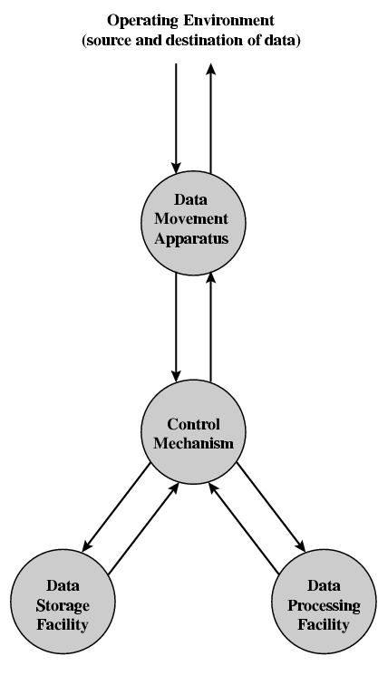
Functional View

Slide 9
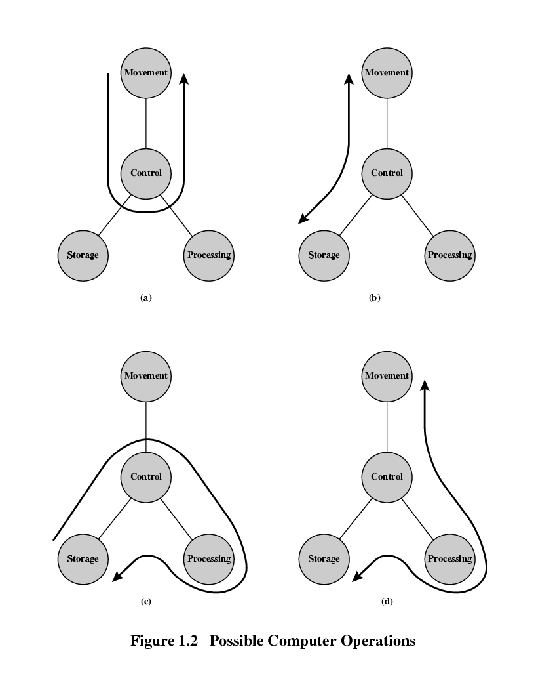
Operations (a) Data movement

Slide 10
Operations (b) Storage

Slide 11
Operation (c) Processing from/to storage

Slide 12
Operation (d) Processing from storage to I/O

Slide 13
Structure - Top Level
Peripherals
Computer
Central
Processing
Unit
Main
Memory
Computer
Systems
Interconnection
Input
Output
Communication
lines

Slide 14
Structure - The CPU
CPU
Computer
Arithmetic
and
Login Unit
I/O
Registers
System
Bus
CPU
Internal CPU
Interconnection
Memory
Control
Unit

Slide 15
Structure - The Control Unit
Control Unit
CPU
ALU
Sequencing
Login
Internal
Bus
Control
Unit
Control Unit
Registers and
Decoders
Registers
Control
Memory

Slide 16
Recommended Book
Computer Organization and Architecture
By- William Stallings 8th Edition

Slide 17
Internet Resources - Web site for book
http://WilliamStallings.com/COA/COA7e.html
links to sites of interest
links to sites for courses that use the book
errata list for book
information on other books by W. Stallings
http://WilliamStallings.com/StudentSupport.html
Math
How-to
Research resources
Misc

Slide 18
Internet Resources - Web sites to look for
WWW Computer Architecture Home Page
CPU Info Center
Processor Emporium
ACM Special Interest Group on Computer Architecture
IEEE Technical Committee on Computer Architecture
Intel Technology Journal
Manufacturer’s sites
Intel, IBM, etc.

Slide 19
Internet Resources - Usenet News Groups
comp.arch
comp.arch.arithmetic
comp.arch.storage
comp.parallel

Slide 20
Question?

Slide 21
Thanks’

